Slide 1
Advanced tools used by Management Consultants

Slide 2
In this section we will discuss the intermediate tools, techniques and
frameworks used by Management Consultants
Rankings
Scenario Analysis
Representative
element analysis
Decision Tree
Analysis
Critical Chain
Theory of constraints
and bottlenecks
Lean Manufacturing

Slide 3
Intermediate tools – Case studies overview

Slide 4
We will help Maria pick the ideal guy / boyfriend. For this try we will use a specific ranking which will take into account 4 criteria
148

Slide 5
We will also analyze whether it makes more sense to buy a car or to use Uber. For that we will use scenario analyses
149

Slide 6
We will help George decide whether it makes sense to go to USA for MBA
150

Slide 7
We will help Adam and Eva pick the best size of the house for their family. They have currently 1 kid but may have more. We will try to pick the optimal solution.
151

Slide 8
We will help Jorge become more efficient. We will do that using the Overall Labor Efficiency Framework and estimate how much he can improve his situation
152

Slide 9
We will help Ivan who wants to improve the work of his team. In this case we will use the bottleneck framework
153

Slide 10
We will help Adrian, who is currently single, find a new girlfriend using the decomposition analysis.
154

Slide 11
Rankings – introduction

Slide 12
Quite often you have options that you want to somehow compare and
rank them
Option 1
Option 3
Option 4
Option 5

Slide 13
Thanks to the ranking you not only give points but you can sort them
from the most wanted to the least desired
Option 5
Option 3
Option 1
Option 4

Slide 14
You may use ranking for many things
Pick the best option from
available options
Rank business ideas
Create priorities for further actions
Motivate
Rank people / team members
Create benchmarks

Slide 15
Rankings are done in 5 steps
Create criteria and weights for the ranking
Define options
Gather data
Calculate the points and create the ranking
Pick the preferred
option
At least 3-4 criteria, preferably independent
Every criteria should have a weight – not all criteria have to have the same importance
You have to define all options that you will be choosing from
For defined options gather data on the criteria so you are able to calculate the points for every criteria and option
Define the rule / function that assigns points for every criteria
Calculate the score for every option- criteria
Using weights calculate the total score
Use the total score to rank the options
You can use
additional criteria
Using the ranking and additional criteria you can pick the preferred option

Slide 16
How to chose the right boyfriend
– Introduction

Slide 17
Let’s imagine that you were to help Maria pick the ideal guy / boyfriend. For this try to use rankings
162

Slide 18
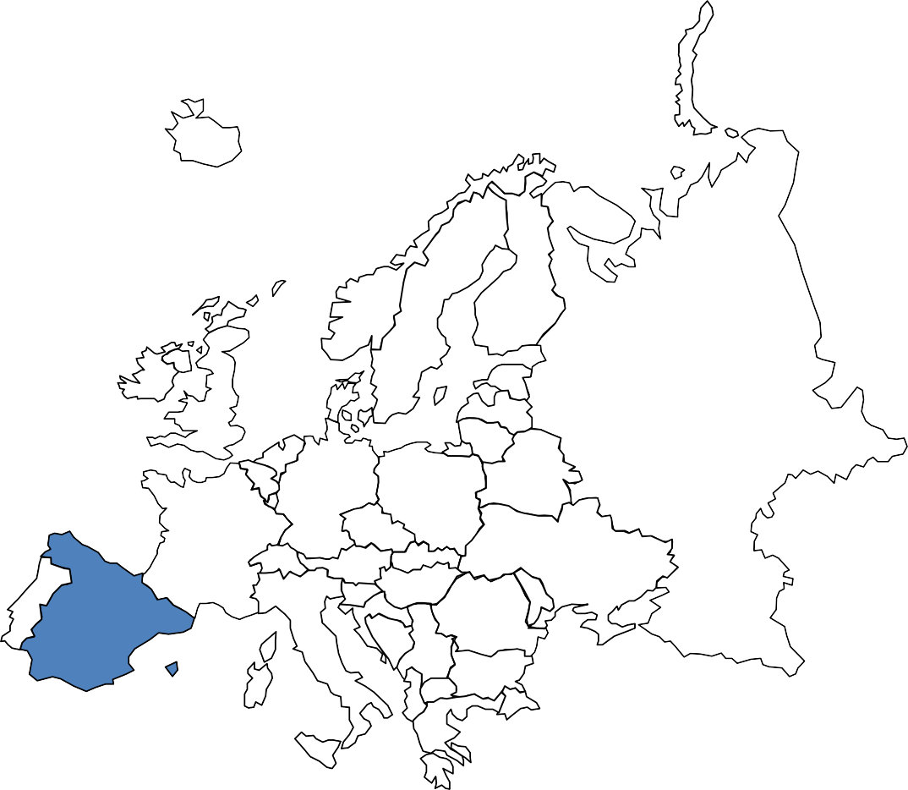
There are a few things that we know about Maria
She has 4 potential candidates
She wants her boyfriend to be nice, intelligent, good looking
From her perspective his earnings and assets matter
She is not sure about importance of specific criteria
163

Slide 19
How to chose the right boyfriend
– Solution

Slide 20
Just as a reminder you were to help Maria pick the ideal guy / boyfriend. For this try to use rankings
165

Slide 21
Let’s summarize the results of our ranking
35
30
10
25
10
20
6
4
15
5
3
6
4
4
10
6
4
5
8
10
6 6
0 0
Alejandro Santiago Jose Pablo
Inteligence Being nice Financial situation Attractivness
166

Slide 22
Scenario Analysis – Introduction

Slide 23
Future is pretty difficult to figure out. You don’t know what will happen. In those cases it is a good idea to consider a few different scenarios
168

Slide 24
Future is pretty difficult to figure out. You don’t know what will happen. In this cases it is a good idea to consider a few different scenarios
169

Slide 25
Imagine that you are ice cream producer and you have to decide how much ice-cream to produce for the next day without knowing what will be the weather. Therefore, you have to consider different scenarios
Scenario 1
Scenario 2
Scenario 3
100
70
30

Slide 26
The scenario analysis consists of 5 steps
Define the thing (goal function) you want to analyze
Define which drivers are the least certain
Define the scenarios
Define your behavior / policy
Check the goal function for every policy
You should be analyzing the things that are threatened by different scenarios and are important for your business
It can be profit, NPV from new investment, inventory you should have etc.
Concentrate on drivers that have big impact and big volatility
It is good to define 3-5 different scenarios
In every scenario the main drivers will have different value
You should assign certain probability to every scenario
Scenarios do not depend on you but your behavior does.
You can define a policy / behavior that helps you in a specific situation
The aim of this step is to pick the right policy, given the scenarios and their policy
The best policy is the one that gives you highest benefits (highest goal function)

Slide 27
Car vs Uber – Introduction

Slide 28
Let’s imagine that you were to decided whether it makes more sense to buy a car or to use Uber
173

Slide 29
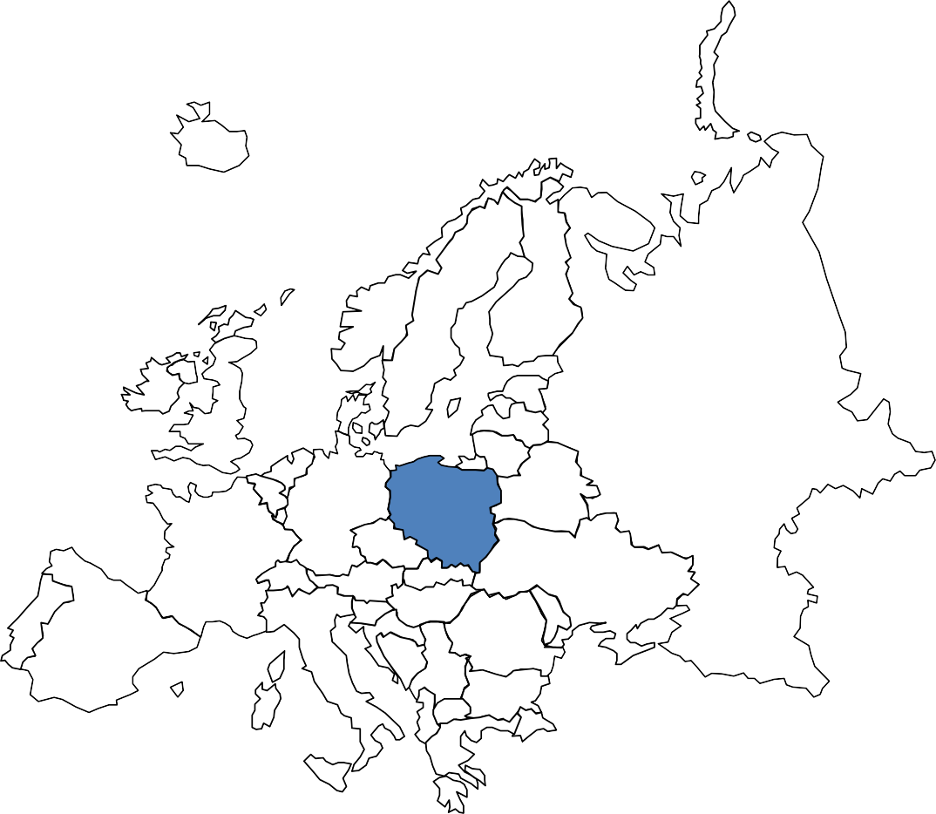
We will consider 3 scenarios
Consider 3 scenarios
In scenario 1 you use the car just to get to work
In scenario 2 you use it also for buying and visiting friends
In scenario 3 you also travel on weekends

Slide 30
Let’s see what is the difference for
Scenario 1 - just to get to
work
20
Scenario 2 - work, shopping,
friends
26
Scenario 3 - work, shopping,
friends, weekends
30
# of days during which you use the car during the month
Average # of km per
day covered
50
70
90
% probability of scenario
50%
30%
20%

Slide 31
A few hints on what costs you should take into consideration
for the own car option
Purchasing of the car & financing
Fuel
Maintenance
Parking
Insurance
Other costs i.e. traffic tickets

Slide 32
Representative element analysis – Introduction

Slide 33
In many cases there are a lot of options that you can consider. For simplicity you
want to limit the options and get down to 1-5 representative elements
178

Slide 34
There are usually 2 main ways to use representative element analysis
Average
3 options

Slide 35
Thanks to representative element analysis you can achieve a
lot of interesting things
Compare different solutions and
decide which is better
Create benchmarks
Compare different offers and decide which is better
Plan & Forecast
Find optimal solution
Do the segmentation

Slide 36
Decision Tree Analysis

Slide 37
Quite often you have to make important decision faced with uncertainty. In those situation it is very useful to apply the so called decision tree
182

Slide 38
Let’s have a look at example. You are to build a chocolate factory. You
have to decide on the size of it.
Outcome
In M USD
60%
Big Demand
(EBITDA= $100 M)
50
Big Factory
(Invest $50 M)
40%
Small Demand
(EBITDA= $20 M)
-30
What factory you
should build?
60%
Big Demand
(EBITDA= $50 M)
20
Small Factory
(Invest $30 M)
40%
Small Demand
(EBITDA= $30 M)
0

Slide 39
Once you have the outcomes for each and every option it is time to
calculate the expected value for both decisions
Expected Value
Outcome 1
Probability of
Outcome 1
Outcome 2
Probability of
Outcome 2
=
x
+
x
Expected Value for Big Factor
50
60%
- 30
40%
18
=
x
+
x
=
Expected Value for
Big Factor
20
60%
0
40%
12
=
x
+
x
=

Slide 40
Once you have the outcomes for each and every option it is time to
calculate the expected value for b
oth decisions Outcome
In M USD
^{60%} Big Demand ^{▪ 50}
(EBITDA= $100 M)
40%
Small Demand _{▪ -30}
(EBITDA= $20 M)
Big Factory
(Invest $50 M)
18
What factory you should build?
^{60%} Big Demand _{▪ 20}
(EBITDA= $50 M)
^{40%} Small Demand _{▪ 0} (EBITDA= $30 M)
Small Factory
(Invest $30 M)
12

Slide 41
How big house should we build – Introduction

Slide 42
Let’s imagine that you have to help Adam and Eva pick the best size of the house for their family. They have currently 1 kid but will have more. Pick the optimal solution.
188

Slide 43
A few information about Adam and Eva
They may have in total 2 or 3 kids
They will have 2 kids with probability 60%
Small house costs EUR 150 K
Big house costs EUR 250 K

Slide 44
If the house is too big or too small they will have cover additional costs
Not used space
Renting
In K EUR
additional space
In K EUR
60%
2 kids
▪ 50 ▪ 0
Big House
(Invest EUR 250 K)
40%
3 kids
0
0
How big house
should they build
60%
2 kids
0
0
Small House
(Invest EUR 150 K)
40%
3 kids
0
151

Slide 45
How big house should we build – Solution

Slide 46
Just as a reminder you were to help Adam and Eva pick the best size of the house for their family. They have currently 1 kid but will have more. Pick the optimal solution.
192

Slide 47
If the house is too big or too small they will have cover additional costs
Not used space
Renting
In K EUR
additional space
In K EUR
60%
2 kids
▪ 50 ▪ 0
Big House
(Invest EUR 250 K)
40%
3 kids
0
0
How big house
should they build
60%
2 kids
0
0
Small House
(Invest EUR 150 K)
40%
3 kids
0
151

Slide 48
Let’s see what is we get after the calculation in Excel
Renting
^{Not used space} additional space
In K EUR _{In K EUR}
60% ▪ 50 ▪ 0
2 kids
40%
3 kids ^{▪ 0 ▪ 0}
Big House
(Invest EUR 250 K)
-280
How big house
should they build
^{60%} 2 kids ^{▪ 0 ▪ 0}
^{40%} ▪ 0 ▪ 151
3 kids
Small House
(Invest EUR 150 K)
-210

Slide 49
OLE

Slide 50
Overall Labour Efficiency how much work there is in the work
☺?
Workday
Time that you can devote
100%
100 %
No work due to organizational issues
Time left for real work
Lack of work
x
54%
54 %
Movement
Work
x 70 %
70%
Work well done
98%
98%
OLE = 37%
196

Slide 51
Removing bottlenecks

Slide 52
Bottlenecks are dangerous as their hurt the efficiency of the whole system

Slide 53
What is the throughput of every system and where
is the bottleneck?
Example 1
x
Stage capacity
7
5
7
Example 2
5
10
20
Example 3
5
5
3

Slide 54
The are 4 rules that you should follow when it comes to
bottlenecks
Identify what is the bottleneck
Increase its throughput by lowering the time needed for
everything that goes through the bottleneck
Add new resources to bottleneck
Adjust everything to the bottleneck – so it works at the
same pace

Slide 55
Content marketing agency – Introduction

Slide 56
Your friend Ivan works in a content marketing agency and wants to improve the work of his team. Help him using the bottleneck framework
204

Slide 57
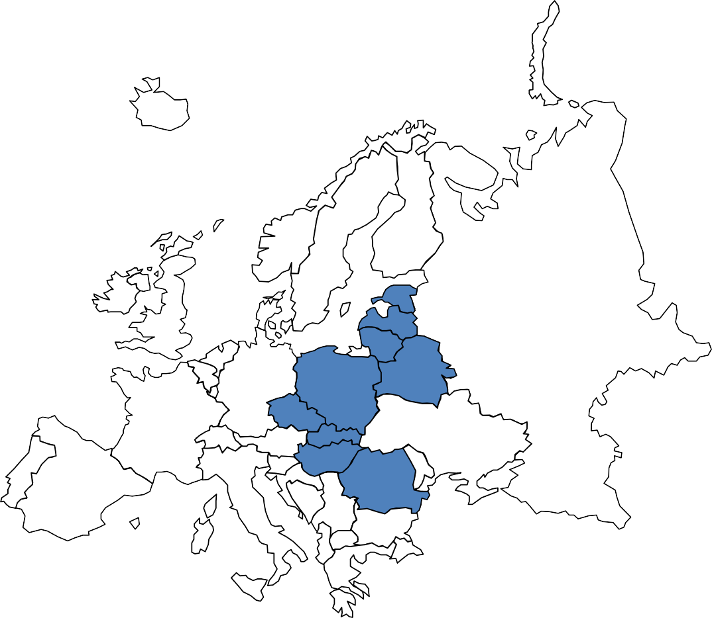
A few things about Ivan team
He manages 4 people
Every person specializes only in 1 area
You measure your success in number of posts produced

Slide 58
Below you can see the production capacity for each and every stage.
1 person works on 1 stage only
xx
# of post that can be done in a week by 1 person
Research topics for a post
Write a post
Create illustration
Edit and modify
post, add illustration and schedule
20
5
7
10

Slide 59
Content marketing agency – Solution

Slide 60
Your friend Ivan works in a content marketing agency and wants to improve the work of his team. Help him using the bottleneck framework
208

Slide 61
Just as a reminder a few information about the content marketing
agency
He manages 4 people
Every person specializes only in 1 area
You measure your success in number of posts produced

Slide 62
Let’s see how we could increase production of posts
xx
# of post that can be done in a week by 1 person
Research topics for a post
Write a post
Create illustration
Edit and modify post, add illustration and schedule
20 |  | 5 |  | 7 |  | 10
20 |  | 8 |  | 7 |  | 10
10 |  | 9 |  | 10 |  | 10
Speed up the writing process (faster typing, better tools, shortcuts for the most popular words)
Make the researcher do also par time
writing and making illustration
We have almost doubled the production of post with the same resources
The same principles would apply if all the activities were done only by you – in this case it would mean that you should not do too much research and illustration but rather improve the typing speed and match the number of illustration and researches to your capacity in writing
If you have no impact on the process (you are one of the guys above just doing his own part and your boss does not
want to listen to you then simply do less – identify the bottleneck and adjust your speed to his speed.
On the other hand if you are the bottleneck then speed up because the whole team depends on you.

Slide 63
Critical Chain

Slide 64
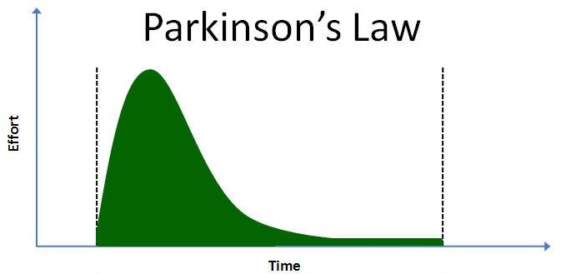
One of the biggest problem for efficiency is the so called Parkinson’s Law –
Work expand so as to fill the time available for its completion

Slide 65
People when asked to evaluate the time certain things will take build in
buffers
Declared time
Buffer time
A
B
C
Real execution
A + B + C
A + B + C
A | B | C | Central buffer

Slide 66
Simulation analysis – Introduction

Slide 67
Future is pretty difficult to figure out. You can use scenario analysis or you check ALL the potential options and see which is optimal
216

Slide 68
Imagine for a second that you have a small bakery trying to decide what is the optimal
number of cakes that you should bake. You want to use simulations to find out
217

Slide 69
For the producer of cakes that at the same time can bake from 1 to 10 cakes using the simulation to find optimal production batch would entail calculating the costs for all options

Slide 70
There are plenty of things you can do thanks to simulations
Find optimal solutions
Test the boundaries of the system
Carry out sensitivity analysis
Find weak spots
Plan & Forecast
…..

Slide 71
Decomposition analysis – Introduction

Slide 72
Decomposition analysis shows you what are the components, driving forces behind certain phenomena. Imagine for a second that we are analyzing revenue growth of a FMCG company
Revenue Growth

Slide 73
We would like to break it down to following components. This decomposition helps us see how we managed to grow the revenues
New customers
New products
Others
Increased price
Increased sales in existing customers and products

Slide 74
Decomposition analysis helps you achieve a lot of goals
Pick the biggest contributor
Create a business model based on drivers and KPIs
You will know what to focus on to get the required effect
Forecast / Plan the future
results
Check to what extent you were
dealing with one-offs
Evaluate the business / business
unit

Slide 75
How to find a new girlfriend – Introduction

Slide 76
Adrian is single again and wants to understand better what is the best way to pickup girls. Have a look at his history and help him
225

Slide 77
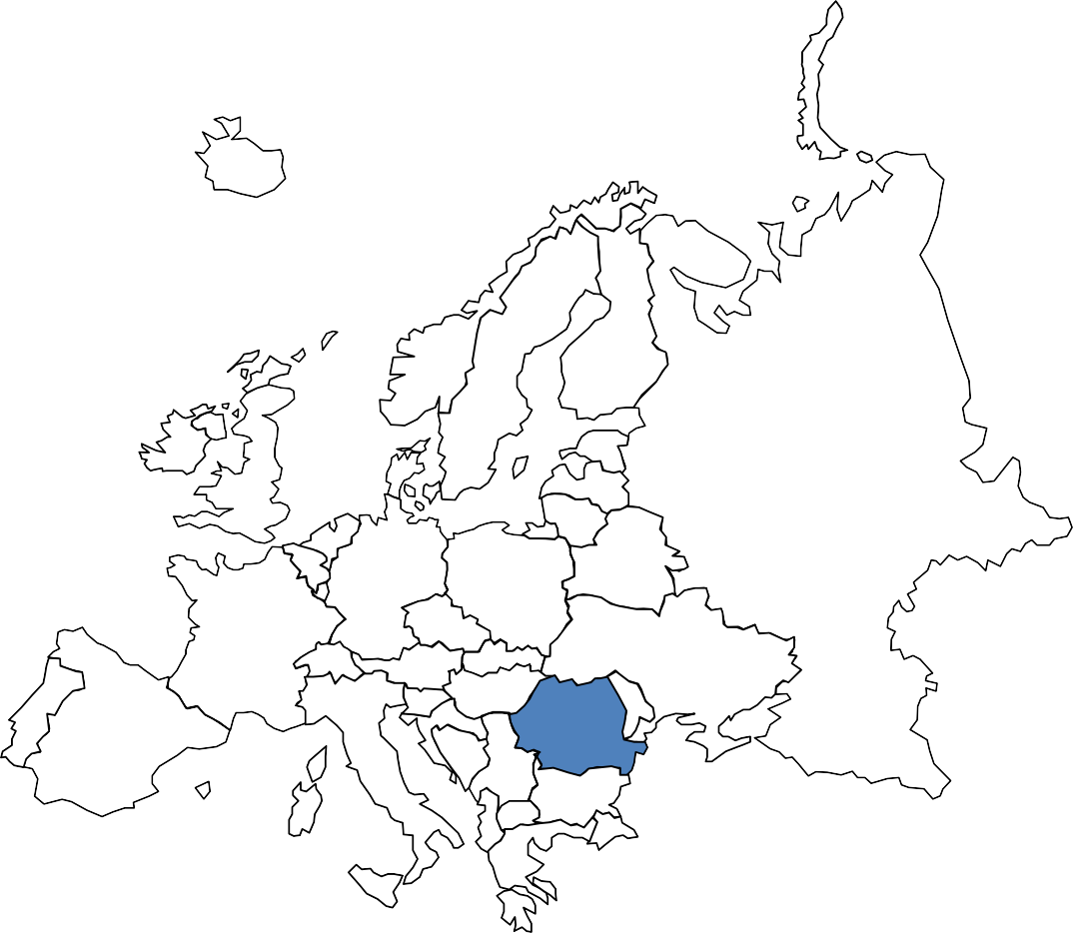
A few things about Adrian. As a first task create a framework to analyze
the history
He wants to understand the drivers of historical successes
Adrian wants to know what he should do to be more successful
Use the decomposition analysis to help him
226

Slide 78
How to find a new girlfriend – Decomposition framework

Slide 79
Let’s have a look at the general framework
Output KPIs
Driving KPI
# of Potential Girlfriends
x
# of Potential Candidates
% conversion rate
x
x
# of Potential Candidates per opportunity
# of opportunities
Probability that she will give her phone number
Probability that you will convert her into a potential girlfriend
228

Slide 80
Feasibility analysis – Introduction

Slide 81
In feasibility analysis you want to check whether something is possible or what are the limitations that you have to consider
230

Slide 82
In feasibility analysis you are given the goal you have to achieve. Now you need either to find the limitation or alternative ways to reach that goal
Limitation 1
Way to achieve
the goal 1
Limitation 1
Limitation 2
Way to achieve the goal 2
Limitation 2
Goal
Limitation 3
Way to achieve the goal 3
Limitation 3
Limitation 4
Way to achieve the goal 4
Limitation 4

Slide 83
There are plenty of things you can do with feasibility analysis
Identify the limitation you have to
remove to achieve the goal
Find directions in which you can to
develop your company
Pick the most interesting way to achieve the set goal
Build a strategy for a business unit
Check what are the limitation behind alternative ways to achieve the goal

Slide 84
How to increase the net profit by 10% – Introduction

Slide 85
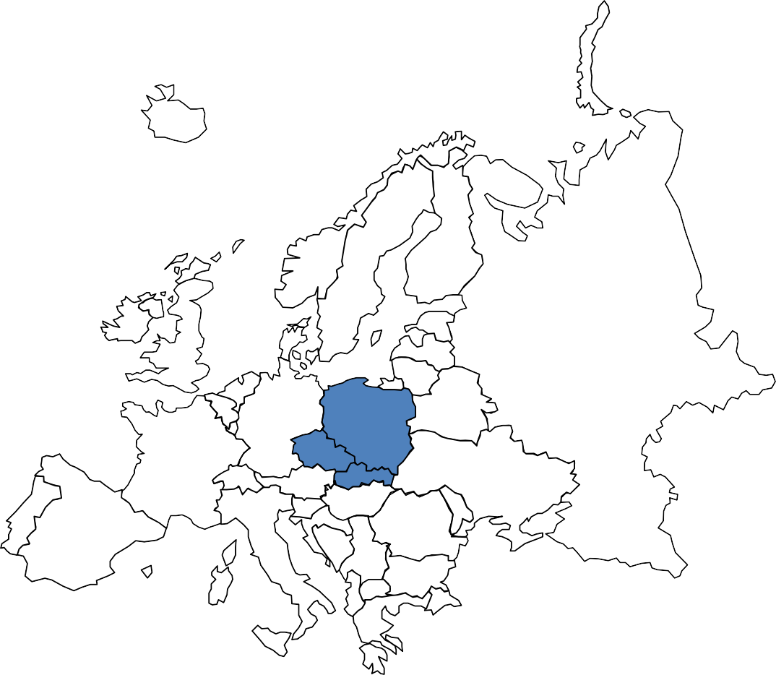
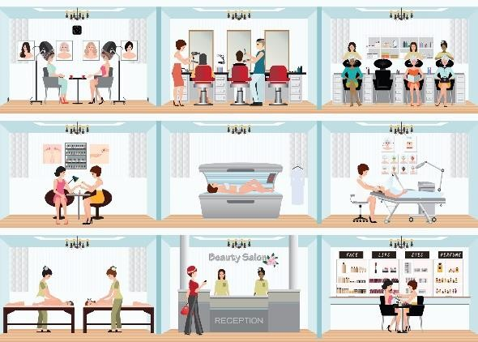
Imagine that you supporting a beauty saloon chain in Easter Europe in
their attempt to increase net profit
50 location in Easter Europe
They mainly do manicure
They are looking for ways to increase profit by 10%

Slide 86
There are number of ways in which you can increase the profit by
10%
Get new customers
Increase prices
Convince existing ones to come
more often
Introduce new product
Upsell and cross-sell customers during their visit

Slide 87
How to increase the net profit by 10% – Solution

Slide 88
Imagine that you supporting a beauty saloon chain in Easter Europe in
their attempt to increase net profit
50 location in Easter Europe
They mainly do manicure
They are looking for ways to increase profit by 10%

Slide 89
Commodity is a basic good used in commerce that is interchangeable with other commodities of the same type
Required change to increase net margin
Description by 10%
Option 1 – Increase price
We increase the price for manicure for all customers
Current price is 25 USD per visit
5% increase of the price
Option 2 – Increase Frequency
We increase the frequency of visiting our beauty shop
Currently, an average customer does 1.4 visit per customer
Increase from 1.4 to 1.6 visit per customer
Option 3 – Increase Customer Base
We increase customer bases size – acquire new customers
Currently, we have 60 K of customers per shop
Increase customer base from 60 K to 68 K
Option 4 – New product
We introduce new product
Currently we do not sell any additional product
We need 36% of our customer to buy the new product

Slide 90
Sensitivity analysis
– Introduction

Slide 91
Once you come up with an optimal solution you want to see how sensitive it is to small changes in underlying assumptions. The solution can be pretty stable….
Current Solution - Current Solution - Current Solution - Current Solution -
7% 5% 2% 1%
Current Solution Current Solution Current Solution Current Solution Current Solution
+1% +2% +5% +7%

Slide 92
… or the contrary very volatile
Current Solution - Current Solution - Current Solution - Current Solution - Current Solution 7% 5% 2% 1%
Current Solution Current Solution Current Solution Current Solution
+1% +2% +5% +7%

Slide 93
You want to carry out a sensitivity analysis for many reasons
Volatility means risks
Sensitivity analysis helps you manage expectations
You want to prepare for the risk / hedge against the risk
Sensitivity analysis is basis for managing a portfolio of projects
In some cases you may want to choose less sensitive option

