Slide 1
BCG,GE,Mckinsey
models

Slide 2
BCG, GE, Mckinsey
▶
Tools for strategy formulation
▶ 1) BCG matrix
▶ 2)GE matrix
▶ 3)7-S McKinsey model

Slide 3
Bcg ---
▶ Boston consulting group growth share matrix
▶ Market growth rate
▶ Firms relative position in the industry

Slide 4
Bcg—
▶ Some firms may have high market share and some may have low market share.
▶ For some businesses, market growth rate may be attractive while in others the growth rate may be very poor

Slide 5
Bcg--
▶ The matrix classifies business of a firm into four distinct categories on the basis of Market growth rate and firms relative position in the industry

Slide 6
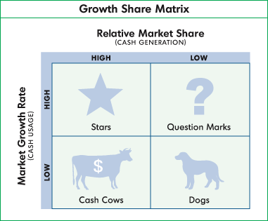
Bcg--

Slide 7
Bcg--
▶ Stars & question marks appear in high Market growth
▶ Star is a market leader and question mark is a follower

Slide 8
Bcg-
▶ Cash cows & dogs appear in low Market growth.
▶ A cash cow is a market leader while the dog is a poor follower.

Slide 9
Bcg--
▶ Stars need good investment support since it operates in a high growth market.
▶ Stars normally do not bring in immediate profits but holds out great potential for the future.

Slide 10
Bcg--
▶ Question marks—unlike stars their future is uncertain.
▶ In addition they are in high risk category while stars are in the medium risk category.

Slide 11
Bcg--
▶ Cash cows-- net generator of resources.
Bring lot of cash to the company
▶ Brings higher profits. Do not need heavy investments.
▶ Industry growth is low so expansion possibility or need of investment is minimal.

Slide 12
Bcg--
▶ Dogs—Low industry growth and low MS.
▶
.--cash traps
▶ One or two businesses of company are stars, one or two may be cash cows, few may be question marks and few may be dogs.

Slide 13
Bcg--
The company has to decide what to do with each business. when the firm completes this exercise, the top managers are very clear about the analysis.

Slide 14
Bcg--
▶ 1) what to do with question marks?
▶ 2)can few of them turn to stars tomorrow with the support of right investment & promotion?
▶ 3)What can be done to strengthen stars?
▶ 4)is the time ripe to totally milk any of the cash cow ?
▶ 5) which of the dogs should be sold out immediately?

Slide 15
Bcg--
▶
Wokhardt- BCG matrix
▶ Stars-bulk drug business & export business
▶ Cash cows—domestic formulation business
▶ Question marks—animal health, diagnostics
▶ Dogs—neutraceuticals, hospital division

Slide 16
GE MODEL
▶
GE MATRIX
▶ Any company can appropriately rate its different businesses for the purpose of strategic planning on the basis of two parameters
▶ industry attractiveness & company's business strength

Slide 17
GE model
▶ How attractive is the industry?
▶ How strong is the firm in the industry?
▶ The firms would like to operate in the most attractive industries and excel through its distinct strength.

Slide 18
Ge model
▶
Basic approach of GE model
▶ When the industry is highly attractive and the company has the best of strength for excelling in that industry, the business is rated as the most important one for the company. When the industry concerned is least attractive and the company's strength in excelling in that industry is very low, the business is rated as the least important one.

Slide 19
Ge matrix
▶
industry attractiveness
▶
1) Industry potential
▶
2)industries current size
▶
3)industry growth
▶
4)industries structure
▶
5)industry profitability

Slide 20
Ge matrix
▶
company's (Enterprise) business strength
▶
1) current market share
▶
2)growth rate
▶
3)differentiation strength
▶
4)Brand image
▶
5)corporate image

Slide 21
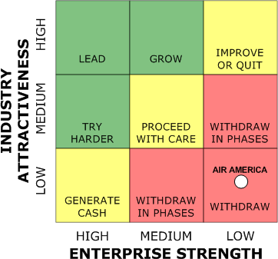
GE matrix

Slide 22
Ge matrix
▶
Divided into nine cells
▶ The upper left zone represent businesses that are most important to the company
▶ The lower right zone represents businesses that are least important to the company

Slide 23
Ge matrix
▶ The central diagonal zone represents businesses that are medium in their importance.
▶ Using the ratings in the matrix, the firm can appropriately set its objectives and strategies in respect of each of its business.

Slide 25
Mackinsey -7 s model
-- used as an organizational analysis tool to assess and monitor changes in the internal situation of an organization
▶ Purpose—1)To improve performance and deliver the objectives
▶
2)To maintain performance in the event of a change

Slide 26
Mckinsey--
▶
If the ORG to perform well, these seven
elements need to be aligned and mutually reinforcing. This model helps identify what needs to be realigned to improve performance, or to maintain alignment and performance during any change.
▶ Types of changes – restructuring, new processes, organizational merger , new systems, change of leadership

Slide 27
Mckinsey—7 S MODEL
Strategy is the only element that determines the performance.
▶ Strategy is the final outcome of shared values
▶ and the latter is the outcome of system, structure, style, skills, staff.

Slide 28
McKinsey
▶ Strategy values
shared
▶
skills staff style
▶
▶
Structure
▶
Systems

Slide 29
Mckinsey—7 S
▶ Strategy, system, structure—Hard elements
▶ "Hard" elements are easier to define or identify and management can directly influence them eg- strategy statements; organization charts and reporting lines; and formal processes and IT systems.
▶ Shared values, style, skills, staff—Soft elements
▶ "Soft" elements, on the other hand, can be more difficult to describe, and are less tangible and more influenced by culture.

Slide 30
Mckinsey
▶ Shared values --- what an organization stands for and believes in. This includes things like the long term vision of the organizations, its charitable ideals, or its core guiding principles. Eg-- the core guiding principle at McKinsey is professionalism.
▶ Eg-Tata group—core values—Integrity, unity
▶
Toyota Motors---Integrity, Humility
▶ Staff refers to the number and type of people employed by the organization.
▶ Skills refers to the learned capabilities of staff within the organization.

Slide 31
Mckinsey-7 s
▶ Style----
▶ Style refers to the way things are done within the organization, that is, the work culture.
▶ A leader inculcates the work culture.
▶ Org do well because of good leadership
and they fail because of bad leadership. what type of goal gets chosen by the
▶
organization will determine what type of leadership will fit

Slide 32
Mckinsey--
▶ Strategy refers to the action plans an org has for the allocation & optimization of its resources to achieve specific goals.
Structure refers to the shape the ORG would create to deliver its objectives. Eg– Tall structure or a flat structure
systems are the practices and procedures that an org uses to get things done, e.g. financial systems, information systems, recruitment systems

