Slide 1
Basic tools used by Management Consultants

Slide 2
In this section we will discuss the basic tools, techniques and
framework used by Management Consultants
Bottom-up approach
Top-down approach
Backward logic
Compounded effect
Issue Tree
Priorities
Benchmarks
80/20 rule
Opportunity Tree
KPIs and business
drivers
Theory of constraints
and bottlenecks
12

Slide 3
Case studies overview

Slide 4
We will help Tomasz estimate the costs of the wedding
14

Slide 5
We will help Lucas estimate how much his colleagues earn in the other department. For that we will use the top-down approach
15

Slide 6
We will help Peter decide at what age he can retire using his own savings. For that we will use backward reasoning
16

Slide 7
He will help John find out the main reasons why his flat is so dirty. For that we will use the issue tree
17

Slide 8
We will also help Ann decide whether it makes sense or not to take the course for fast reading and what could be the benefit of that
18

Slide 9
We will help Kate to lose weight. We will use the low hanging fruit approach to map all the potential solutions and pick the easiest ones.
19

Slide 10
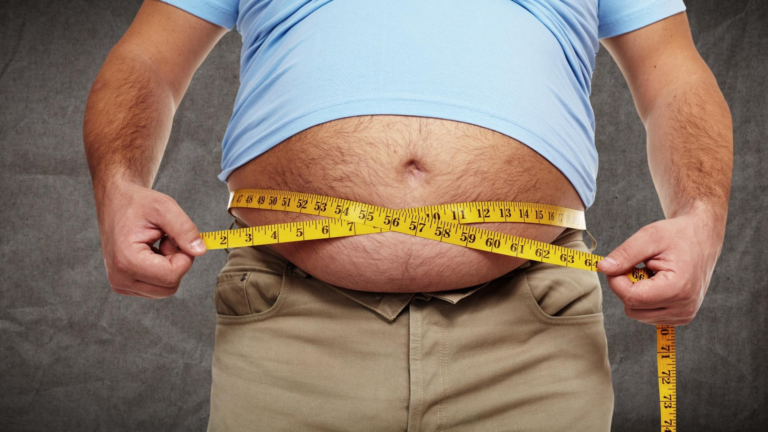
We will help Tom get in shape by using the SMART goal framework. He has only 9 months to achieve his goals
20

Slide 11
We will help Giuseppe to define the personal KPIs that will help him make sure that he is increasing his chances of being happy
21

Slide 12
Bottom-up approach

Slide 13
…the one you will for sure use is bottom-up approach where you go from single (typical) consumer to market research
First you should imagine the typical users
Then you should try to guess his consumption level
By estimating the number of typical users you and their consumption level you get the rough size of the market
13

Slide 14
…sometimes it makes sense to divide markets in segments and estimate them separately (i.e. average and typical users, women and man, people in different age groups or segmentation by lifestyle)
Segment A
Segment B
14

Slide 15
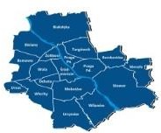
…lets do a simple example. Imagine that you want to make an application for franchised restaurants
You pick the sample group / area you want to estimate i.e. city (here Warsaw)
You count the number of all restaurants in the area
For the chosen area you count the franchising restaurants
Assuming similar density as in Warsaw you scale up the number of franchised restaurants proportionally to the population
You check the population of the whole country – here Poland
25

Slide 16
…to make you better at this method imagine you want to sell home made dog food….. First you have to estimate how many dogs they are…..
+
Once you have the number also calculate how many households they are in the sample
First you should pick your sample – can be your friends or neighbors
Next step is to calculate how many dogs they have
And assuming similar proportion as in your sample you scale up the number of dogs
It is now enough to know how many households there are in the country
16

Slide 17
number of food eaten per year by average dog…..and you get
to the size of the food market
…with the number of dogs you just have to estimate the
+
This requires us to estimate additionally how much
food would average dog eat per year
We have the number of dogs in the whole country. Now we have to get from here to the dog food
In this way using annual average consumption per dog and the estimated number of dogs we are able to estimate how much food is eaten every year in the country
17

Slide 18
Lets sum up the bottom-up approach
Bottom-up approach enables you to estimate within one minutes the indicative size of the market
It is very good for the B2C markets
For better estimation you should segment customers and increase the sample size
18

Slide 19
Estimating the costs of a wedding
– Introduction

Slide 20
Imagine that you have to estimate the costs of the wedding to help Tomasz plan his wedding. Use for that the bottom-up approach
31

Slide 21
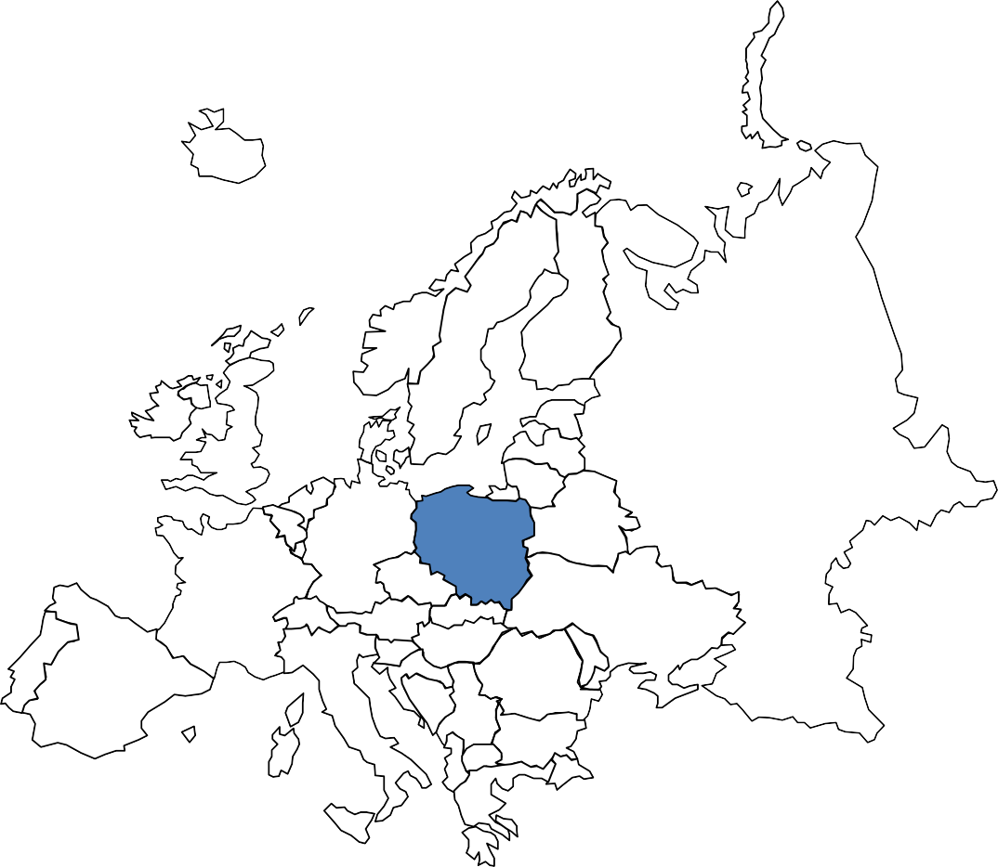
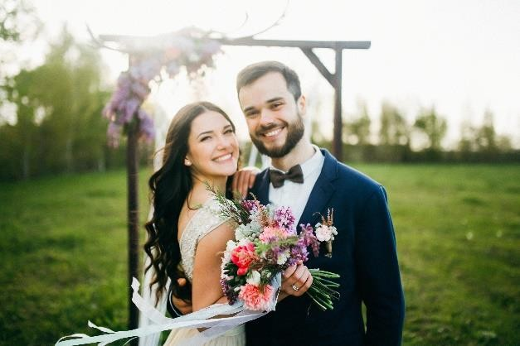
Imagine that you have to estimate using bottom-up approach the costs
of the wedding. A few information we have
200 guests
40% will need a hotel
20% of them have kids.
There will be a band and entertainment for kids
32

Slide 22
Estimating the costs of a wedding
– Solution

Slide 23
Just as a reminder you have to estimate using bottom-up approach the
costs of the wedding
200 guests
40% will need a hotel
20% of them have kids.
There will be a band and entertainment for kids
23

Slide 24
First let’s think about what kind of cost positions you have
Food & Drinks
Flowers
Hotel
Entertainers for the kids
Clothes (bride and the
groom)
Church costs
The band
Other costs
The place / venue
24

Slide 25
First let’s divide the cost into 2 groups: fixed and depending on
the number of guests
Food & Drinks
Flowers
Hotel
Entertainers for the kids
Clothes (bride and the
groom)
Church costs
The band
Other costs
The place / venue
25

Slide 26
Let’s see how we can estimate the costs of food & drinks, hotel,
place / venue
# of guest requiring hotel
% of guest requiring hotel
÷
# of rooms needed
Cost per 1 room
# guests
Cost of food & drinks per 1 guest
x
# of guests per 1
room
x
Hotel costs
Food & drinks costs
x
x
# sq m (space)
Space per 1 guest
Place venue costs
x
Cost per 1 sq m
26

Slide 27
Let’s see how we can estimate the costs of entertainment and flower
costs
# of guests with kids
% of guests with kids
x
# of kids
Cost per 1 kid
# guests
Cost of food & drinks per 1 guest
x
# of kids per 1
guest
x
Entertainment
costs
Food & drinks costs
x
÷
# of vases
# of guests per 1 vase
Flower costs
x
Cost per 1 vase
27

Slide 28
After we have calculated every cost position we have to sum them
up to get the total cost of the wedding
Food & drinks costs
Hotel costs
Place / venue costs
Entertainment costs
Flower Costs
Clothes (bride and the groom)
The band
Church costs
Other costs
Cost depending on
the # of guests
Fixed costs
+
+
+
Total cost of the wedding
28

Slide 29
Top-down approach

Slide 30
When to use top-down approach?
You know the size of the whole market
You are interested in a specific segment of the market
Segment is big enough
You are thinking about niche strategy or low cost strategy (market re-segmenting)
30

Slide 31
For a change lets see how it would work with top-down approach
You use the total market size to get to the size of the segment in which you are interested
You have to use some sort of sample measure
By applying the result from the sample you can get to the size of the segment in which you are interested
31

Slide 32
… let’s use the top-down approach to estimate the market for science fiction books sold in Poland….
You use the total number of books sold in your country
Then you go to the bookstore that belongs to the biggest chain of bookstore and check what percentage of the shelves are take by science fiction books
If you use this proportion to the whole market you should get the rough estimation of the science fiction book segment
32

Slide 33
Average salaries in other department – Introduction

Slide 34
Imagine that Lukas would like to know how much his colleagues in the other department earn. Use the top-down approach
46

Slide 35
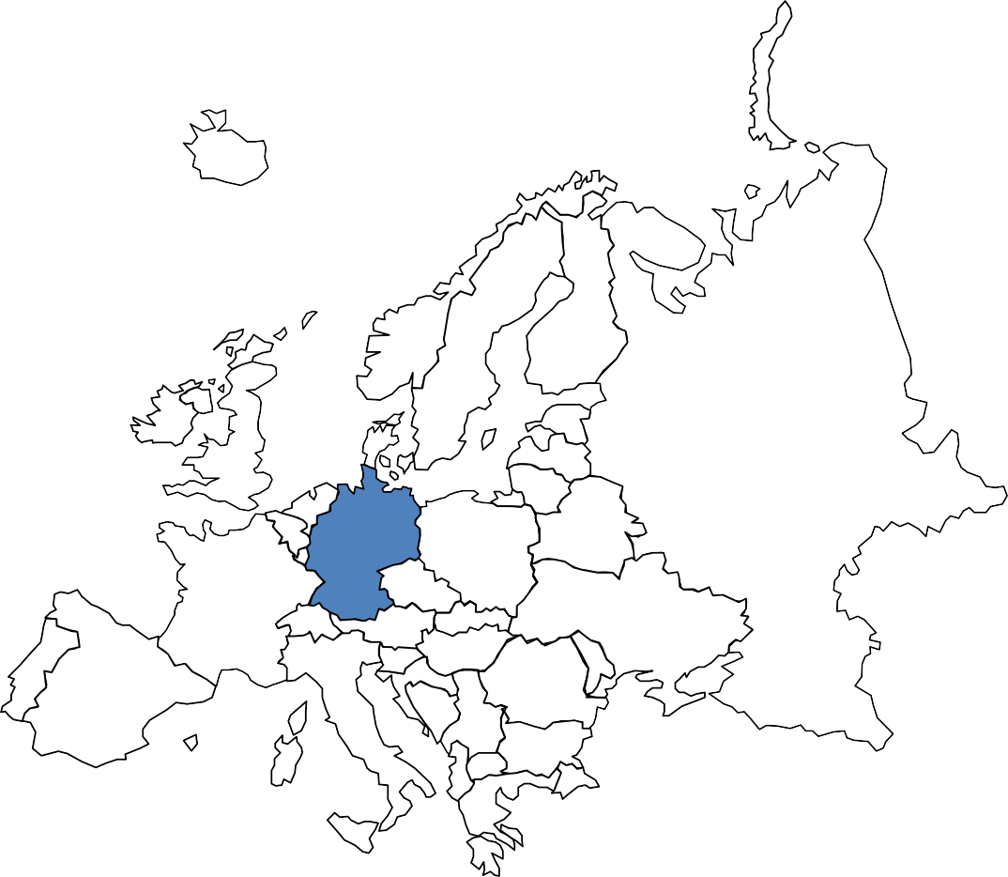
Imagine that Lukas would like to know how much his colleagues in the
other department earn
In total they cost EUR 101 K per month
There are 20 Business Analysts, 2 Associates and 1 Manager
Associate costs 50% more than Business Analyst
The manager costs 50% more than Associate
47

Slide 36
Average salaries in other department – Solution

Slide 37
Just as a reminder you would like to know how much hiscolleagues in
the other department earn
In total they cost EUR 101 K per month
There are 20 Business Analysts, 2 Associates and 1 Manager
Associate costs 50% more than Business Analyst
The manager costs 50% more than Associate
37

Slide 38
Let’s start with the things we know now
Business Analyst Salary
Associate Salary
Manager Salary
Total Salaries
20x
+ 2x
+
=
Manager Salary
Associate Salary
Business Analyst
Salary
Business Analyst
Salary
= 1.5x
= 1.5x 1.5x
= 2.25x
Associate Salary
Business Analyst
Salary
= 1.5x
Business Analyst Salary
Business Analyst Salary
Business Analyst
Salary
Total Salaries
20x
+
2x 1.5x
+ 2.25x
=
38

Slide 39
From this we can calculate the salary of a Business Analyst
Business
Analyst Salary
Business Analyst Salary
Business Analyst
Salary
Total Salaries
20x
+
2x 1.5x
+ 2.25x
=
Business Analyst Salary
Business Analyst Salary
Business Analyst Salary
Total Salaries
20x
+ 3x
+ 2.25x
=
Business Analyst Salary
Total Salaries
25.25x
=
Business Analyst Salary
EUR 101 000
25.25x
=
Business Analyst Salary
EUR 4 000
=
39

Slide 40
And use it to calculate the rest of the salaries
Business
Analyst Salary
EUR 4 000
=
Associate Salary
Business Analyst
Salary
EUR 6 000
= 1.5x
=
Manager Salary
Business Analyst
Salary
EUR 9 000
= 2.25x
=
40

Slide 41
Backward reasoning

Slide 42
Imagine that you were supposed to say how much you have to
spend to create a company that has revenue of $ 100 M dollar
Imagine that you were supposed to say how much you have to
spend to create a company that has revenue of $ 100 M dollar
54

Slide 43
You could use for that the so called backward reasoning
CC: Flickr; Cycle Track
55

Slide 44
Imagine that you were supposed to say how much you have to
spend to create a company that has revenue of $ 100 M dollar
Total Costs
$ 400 M
# of leads 200 K
÷
Cost of 1 lead
$ 2 K
# of customers 20 K
Average revenue per customer
$ 5 K
x
% Conversion 10%
x
Revenues
$ 100 M
44

Slide 45
When can you retire – Introduction

Slide 46
Try to estimate at what age can Peter retire using his own savings. To estimate the age of retirement use the backward reasoning
59

Slide 47
Try to estimate at what age you can Peter retire using his own savings
Life expectancy for man is 80 years old. Peter is currently 30
Peter currently earns 120 K. His current annual costs are 50 K
His annual costs after retiring will be 50 K
Peter has 1 M in savings
60

Slide 48
When can you retire – Solution

Slide 49
Just as a reminder we were to estimate at what age can Peter retire using his own savings. We were to use the backward reasoning for that
62

Slide 50
Just as a reminder you were supposed to estimate at what age you can
retire using your own savings
You are expected to live up to 80 years old. Peter is currently 30
Peter currently earns 120 K. His current annual costs are 50 K
His annual costs after retiring will be 50 K
Peter has 1 M in savings
50

Slide 51
Let’s see how the 2 options compare
At what age you can retire
In years
1,4
42,5
41,1
Age of retiring - no passive income
Age of retiring - with passive income
Difference
51

Slide 52
Compound effect

Slide 53
There are 2 types of compounding effect
Time related
Operations related
Even if the growth is small applied over long period of
time gives big end-results
A lot of small changes in many areas may produce a
big end-results
# of customers
Average revenue per customer
Start x (1+10%)^10
= 2,6 x Start
+15%
+20%
x
Revenues
+38%
53

Slide 54
Create Issue tree

Slide 55
Issue tree - general
Analysis to be
performed
Area of analysis
Suspected problems
Possible reasons
Possible Reason 1 |  | Analysis 1
 |  |  | Problem 1
Area 1
 |  |  | Problem 2
Possible Reason 2 |  | Analysis 2
Possible Reason 3 |  | Analysis 3
Possible Reason 4 |  | Analysis 4
69

Slide 56
Issue tree in Logistics – examples

Slide 57
Issue tree - general
Analysis to be
performed
Area of analysis
Suspected problems
Possible reasons
Possible Reason 1 |  | Analysis 1
 |  |  | Problem 1
Area 1
 |  |  | Problem 2
Possible Reason 2 |  | Analysis 2
Possible Reason 3 |  | Analysis 3
Possible Reason 4 |  | Analysis 4
57

Slide 58
Issue tree – example – chicken meat producer
Analysis to be
performed
Area of analysis
Suspected problems
Possible reasons
Badly designed routes |  | Analysis of designed routes, their length and the influence of possible changes
High costs of transport per ton of goods
Too big fuel usage |  | Analysis of fuel usage and kilometers covered by vehicles
No shipments on the way back |  | Analysis of load carried on the way back
Badly designed method of packaging which makes the product prone to damage |  | Analysis of correlation between type of packaging and percentage of damaged
Transport
Big level of waste and breakage in transport
Speed not adjusted to the product |  | Analysis of time spent on the way and kilometers covered in that time
Badly organized work and schedule of deliveries
Analysis of level of overtime, daily organization of drivers work
Low usage of resources
Limitation on delivery time of finished
goods
Analysis of Clients’ preferences on
delivery time
58

Slide 59
Issue tree in Retail – examples

Slide 60
When you are talking about retail you should have a look a
the following areas
Retail chain development
Expansion model
Product Range / Category Range Management
In-store process
Pricing
HR especially trainings
Logistic / Supply Chain
60

Slide 61
Below you can see example of issue tree in Retail Chain Development
Analysis to be
Area of analysis Suspected problems Possible reasons
performed
Low LFL due to cannibalization (on- line, new stores in old locations)
Analyze the change in sales after opening new stores / on-line introduction
 |  |  | Low growth in sales
 |  |  | Decreasing EBITDA of new stores
Retail chain development
 |  |  | High cost of building new stores
Few new openings in locations |  | Analysis of number of openings vs availability of new places
Increasing rents due not proper usage of purchasing power
Analysis of rents vs comparable
competition
Growing salaries to keep low rotation |  | Salaries growth vs rotation – comparison with competition
No support from the shopping malls |  | Analysis of contracts with shopping malls
Not optimized formats, expensive fixtures |  | Analysis of cost per 1 sq. m, number of fixtures, cost per fixtures
61

Slide 62
Issue tree – example – chicken meat producer
Analysis to be
Area of analysis Suspected problems Possible reasons
performed
Too many supplier of Category A that undermines your purchasing power
Analyze of number of suppliers and their share in sales vs market
Low margin on Category A
Lack of Private Labels |  | Analysis of Private Labels potential – benchmarks and potential supplier
Usage of middlemen instead of direct suppliers
Analysis of whom we buy from Category B and the whole value chain
Product Range Management
Low margin on Category B
Improper planning and allocation by stores |  | Analysis of planning and allocation process
Improper planning and allocation by stores |  | Analysis of planning and allocation process
High inventory cost
Non-responsive supply chain |  | Analysis of lead times, deliverability on- time, level of breakage
62

Slide 63
Issue tree for John's flat – Introduction

Slide 64
Imagine that you would have to create an issue tree for John’s flat. What kind of problem he has and what could be the reasons for that
78

Slide 65
Issue tree for John's flat – Solution

Slide 66
Just as a reminder you had to create an issue tree for John’s flat. You were to guess what kind of problem he has and what could be the reasons for that
80

Slide 67
Below you can see example of issue tree for analyzing the John’s flat
Analysis to be performed
Area of analysis
Suspected problems
Possible reasons
He doesn’t put the things in a dedicated space
Check where he put things. Check whether he has dedicated space for every thing
 |  |  | There is a clutter / mess
The flat
 |  |  | The space is too small
 |  |  | He spends too much time for cleaning and maintaining
He doesn’t clean often enough |  | Analyze the frequency of cleaning
He has too many things that are not used
Analyze what percentage of clothes,
gadgets, dishes etc. he uses
The layout is not practical |  | Map the layout against the activity of John
He has too low furniture which have low capacity
Measure the height of furniture and estimate what space is not used
He has too many open furniture that collect more dust |  | Analyze the furniture he has at his flat
His technique, tools of cleaning are not optimal
Analyze the techniques and tools used along with labor intensity
81

Slide 68
Priorities

Slide 69
Priorities
FCFS – First Come First Served (FIFO)
LCFS – Last Come First Served (LIFO)
Due Date
SOT – Shortest Operating Time
69

Slide 70
What you do depending on the rules you use?
Time
needed for completion In minutes
When it came
FCFS
LCFS
Deadline
SOT
Task
Deadline
Write 1 blog post | ▪ | 01.04 | ▪ | 10.04 | ▪ | 120 | 1 |  | 5 |  | 4 |  | 5
Analyze sales | ▪ | 01.04 | ▪ | 04.04 | ▪ | 30 | 2 |  | 4 |  | 1 |  | 4
results
Send email | ▪ | 02.04 | ▪ | 09.04 | ▪ | 2 | 3 |  | 3 |  | 3 |  | 1
Read 4 articles | ▪ | 02.04 | ▪ | 11.04 | ▪ | ₂₅ 4 2 5 3
Pay for cable TV | ▪ | 03.04 | ▪ | 04.04 | ▪ | ₄ 5 1 2 2
70

Slide 71
Benchmarks

Slide 72
72

Slide 73
Why you need benchmarks?
73

Slide 74
There are 2 types of benchmarks
Internal
External
Based on previous execution
Extremely comparable
Very reliable
Detailed – can be put for each and every activity
Based on some external source (i.e. reports)
Not that easily comparable
They to be treated with caution
Only for chosen amount of activities
Can give you food for drastic improvements - by analyzing them you can find totally different method of working
74

Slide 75
By comparing your results and benchmarks you can decide
what to improve, work on
Current
Internal
External
Area Unit Conclusions
result
Salary | K USD | ▪ | 5 | 4 |  | 7 | Your salary went up in
 |  |  |  |  |  |  | comparison with your previous
 |  |  |  |  |  |  | one but you are still below the
 |  |  |  |  |  |  | market
Speed of typing | words/ minute | ▪ | 40 | 39 |  | 80 | Your typing speed has improved
 |  |  |  |  |  |  | slightly yet you are far below the
 |  |  |  |  |  |  | speed achieved by others
Speed of | minute | ▪ | 15 | 10 |  | 12 | You not only improved your speed
analyzing Excel |  |  |  |  |  |  | of analyzing but also are better than others
 |  |  |  |  |  |  | Makes sense to teach others how
 |  |  |  |  |  |  | to do it
75

Slide 76
Applying 80/20 rule in practice

Slide 77
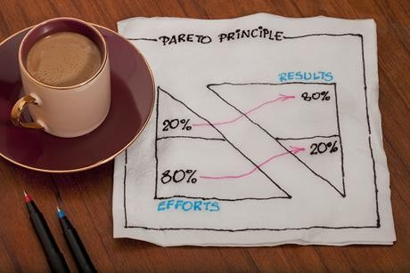
80/20
77

Slide 78
What does 80/20 mean in practice
Concentrate only on the big items
Concentrate on the big customers
Analyze the most typical cases
Concentrate on the most frequently occurring problems
Analyze problems with big impact
Your analyses should have only 20% of the variable that generate 80% of the impact
Start with subjects where you see the biggest difference between actual results and benchmarks
78

Slide 79
Here are 3 examples of using 80/20 rules
Area
Learning Visual Basic for Excel
Description
Learn only the 5 most used items that will take only 20% of full course and will be used by in you in 80% cases
You check only 20% of competitors that sales add-up to 80% of the market
Checking competitors
Salsa course
Go through 20% of the course to learn the moves and the figures used in 80% of cases
79

Slide 80
Low hanging fruits

Slide 81
81

Slide 82
Get the low hanging fruits first. By low hanging fruits we mean things with big impact and easy to accomplish
82

Slide 83
How to find low hanging fruits?
Impact
High
2
1
Things with big impact yet expensive, time consuming
Things with big impact that require little work
No
3
Easy but with low impact
Resources needed Small
Low
Big
83

Slide 84
How to lose weight – Introduction

Slide 85
Imagine that you want to help Kate lose weight. Use the low hanging fruit approach to map all the potential solutions. First list activities
100

Slide 86
How to lose weight – List of potential activities

Slide 87
Just as a reminder you were supposed to help Kate lose weight. The first step is to list all potential activities that can help her achieve the goal
102

Slide 88
Let’s first list all potential ideas
Cut down on sweets by 50%
Hire personal trainer / coach
Buy special meal kit / box diet
Measure calories intake
Run 2 times a week for 30 minutes
Do intermittent fasting
Walk every day 15 K steps
Stop eating carbs / carbohydrates
Eat 2 kg of vegetables every day
Give up sweet beverages
Start drinking green tea
Drink 4 liters of water every day
15 minutes of daily exercises
Plastic surgery

Slide 89
Now try to map all ideas on the low hanging fruit matrix
Impact
2
1
High
4
3
Low
Difficulty level
High
Low

Slide 90
How to lose weight – Solution

Slide 91
Just as a reminder you were supposed to help Kate lose weight. We have the list let’s try to put the on the map and identify low hanging fruits
106

Slide 92
Let’s first list all potential ideas
Cut down on sweets by 50%
Hire personal trainer / coach
Buy special meal kit / box diet
Measure calories intake
Run 2 times a week for 30 minutes
Do Intermittent fasting
Walk every day 15 K steps
Stop eating carbs / carbohydrates
Eat 2 kg of vegetables every day
Give up sweet beverages
Start drinking green tea
Drink 4 liters of water every day
15 minutes of daily exercises
Plastic surgery

Slide 93
Let’s map all ideas on the low hanging fruits matrix
Impact
High
2
1
Eat 2 kg of vegetables every day
Stop eating carbs / carbohydrates
Drink 4 liters of water every day
Do Intermittent fasting
Give up sweet beverages
Cut down on sweets by 50%
Run 2 times a week for 30 minutes
Walk every day 15 K steps
Buy special meal kit / box diet
4
3
15 minutes of daily exercises
Hire personal trainer / coach
Measure calories intake
Plastic surgery
Start drinking green tea
Low
High
Difficulty level
Low

Slide 94
Set SMART goals

Slide 95
The SMAR formula translates to 5 rules you should use when defining the goals
S
Specific – target a specific area for improvement
M
Measurable – it has to be quantifiable; you have to have a way of measuring it
A
Assignable – it says who will do it
R
Realistic – it can be delivered
T
Time-related – it says when it has do be delivered / by which dates

Slide 96
SMART goals should be set for the task but also for skills
Goals for ordinary tasks
Goals for skills
Avoid vague tasks
Always for projects set deliverables, dates and
responsible persons
Merge the task with the goal on the to-do list and set the right pace to a achieve the goal within the defined time
Set goals for improving your skills
Set goals for learning new things
Set goals for making the repetitive things faster and better

Slide 97
Imagine that you want to write a book. Let’s translate it into task with SMART goals
Imagine that you want to write a book
Define the size
of the book and deadline
Divided into small tasks
Make the tasks SMART
Set the pace and execute
200 pages
1 page = 800 characters
Time= 1 year
Write pages
Write 1 page every day
Measure every week completion rate against the target (1 page/day=7 pages/week)
If necessary act to keep the pace

Slide 98
By comparing your results and benchmarks you can decide
what to improve, work on
Current result
Internal External
Area
Unit
Target
Actions
Learn | Level | ▪ | 0 | n/a |  | Intermediate | Intermediate | Sing-in the course
Spanish |  |  |  |  |  |  | in 2 years | Listen to Spanish TV 30 minutes
 |  |  |  |  |  |  |  | every day
Speed of | words/ | ▪ | 40 | 39 |  | 80 | Achieve 60 | Enroll into a on-line course
typing | minute |  |  |  |  |  | words/minute In 3 months | Devote 15 minutes every day to training

Slide 99
Map your skills, experience, skills and set goals where you
want to be
# of projects
Current Target
Industry
Current Target
Experience
Sales projects ▪ 1
Marketing projects ▪ 2
Supply chain projects ▪ 2
Production projects ▪ 3
HR projects ▪ 0
4
6
2
3
1
Skills
Lowest Level
Highest level
Excel
Negotiation
English
Optimizing production
Setting up on-line marketing campaigns

Slide 100
Opportunity tree

Slide 101
Opportunity tree
Opportunities
Traffic
YouTube
Ads on instagram
Affiliation with bloggers
Guest blogging
# of transactions
Gross Margin
% conversion
Long form / Short form
Reduction of delivery methods
No account
Emailing for people abandoning cart
Sales
ATV
Upselling and Cross selling
Free delivery for higher tickets
Introduction of new categories
% Gross Margin
% Front Margin
Reducing number of suppliers
Finding new suppliers
Renegotiation
% Back Margin
116

Slide 102
Cost drivers

Slide 103
Cost drivers are causing the cost to go or down
# of slides
# of hours per 1 slide
Slide preparation
Cost of 1 hour
Cost of a Udemy course
# of lectures
Recording and editing
# of minutes per 1 lecture
Cost of 1 hour
118

Slide 104
KPIs and business drivers

Slide 105
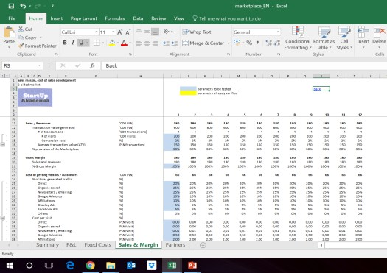
To understand and analyze business you have to identify the drivers / KPIs that a key for specific business and translate it into a model in Excel
x
Cost of traffic
Total searches
% conversion
Ratio of visitors to searches
Rent
+
Average cost of 1 visit
People
x
# transactions
Development
x
Total revenue
Total Costs
Average revenue per transaction
-
x
% Fee of the marketplace
Average transaction value
Total margin

Slide 106
Imagine that you have to estimate typical family spending's. You can take
into account countless number of factors…..

Slide 107
…or you can limit yourself to the most important ones i.e. number of kids,
size of house, main repetitive spending like food.

Slide 108
To measure the selected factors you have to use some sort of KPIs
Spending per 1 person per month per category
# of people in
average family
Average size of the house in sq. m
Average rent per sq. m

Slide 109
Personal KPIs – Introduction

Slide 110
Let’s imagine that you have to define the personal KPIs for Giuseppe that will help him make sure that he is increasing his chances of being happy
125

Slide 111
A few information about Giuseppe
Giuseppe has a girlfriend
He works as a business analyst
His family, health and friends are important to him
He also wants to get more financially sound

Slide 112
To define KPIs I would recommend following a very simple
sequence of actions
Define what areas matter for you
Identify drivers
Define output KPIs
Define input KPIs
Set targets for KPIs

Slide 113
Personal KPIs – Solution

Slide 114
Just as a reminder you were helping Giuseppe define his personal KPIs that will help him make sure that he is increasing his chances of being happy
129

Slide 115
Just as a reminder what we know about Giuseppe
Giuseppe has a girlfriend
He works as a business analyst
His family, health and friends are important to him
He also wants to get more financially sound

Slide 116
KPIs help you manage the drivers of your business model
Define what areas matter for you
Identify drivers
Define output KPIs
Define input KPIs
Set targets for KPIs
Relationships
Family
Health
Work
Financial well-being
Pastime / Hobby

Slide 117
Let’s look how we can define KPIS for the relationship
Area
Drivers
Output KPI
Input KPI
Time spend with his
girlfriend (Laura)
# of times they see each other during the week
# of times he propose to see her during the week
Relationship
Laura’s happiness level
Average # of Laura’s smiles per meeting
# of times she says something nice during the week
# of small gifts given to Laura
# of times he propose to see her during the week
# of times he organizes a nice date (cooking, cinema, restaurant visit) during the week

Slide 118
Let’s look how we can define KPIs for the family
Area
Drivers
Output KPI
Input KPI
Time spend with his
family
# of times they see each other during the week
# of times he accepts invitation from his mother
Family
Family’s happiness level
# of complaints from his mother during the week
# of times he accepts invitation from his mother
# of times he calls his mother
# of times he praises his mother about
her food

Slide 119
Let’s look how we can define KPIS for the health
Area
Drivers
Output KPI
Input KPI
Be in shape
His weight
The size of his muscles
# of times he runs a week
# of times he visits the gym
Average number of kcal per day consumed
Health
Have no illnesses
# of illnesses he is suffering from during specific week
Average sleep per day
Average number of kcal per day consumed
Vegetables as a % of his food intake
Alcohol consumption per week

Slide 120
Let’s look how we can define KPIS for the work
Area
Drivers
Output KPI
Input KPI
His salary
His salary
% salary increase over the year
Additional income per month
# of networking meetings per month – internal
# of networking meetings per month – external
Money invested in additional businesses
CVs / resume sent to other firms
Work
Doing interesting new things
# days during the month during which he did interesting things
# of networking meetings per month – internal
Quality of his work from 1 to 10 – measured by people who work with him
# of praises he got during the month
# of attempts to get into interesting
projects per month

Slide 121
Let’s look how we can define KPIS for the financial well-being
Area
Drivers
Output KPI
Input KPI
His net value
Net value in EUR
% of his salary not spent during the month
Additional money invested
Additional income generated
Financial well-being
Generate positive CF
Cash flow generated during the month
Positive cash flow generated during the month as % of his salary
% of his salary not spent during the month
Additional income generated

Slide 122
Total cost of ownership

Slide 123
Let’s start with a short definition
Total cost of
ownership
=
All the cost related to owning or using a specific item / thing
It will also include the cost of lost opportunity i.e. money not earned due to spending time on repairing the thing

Slide 124
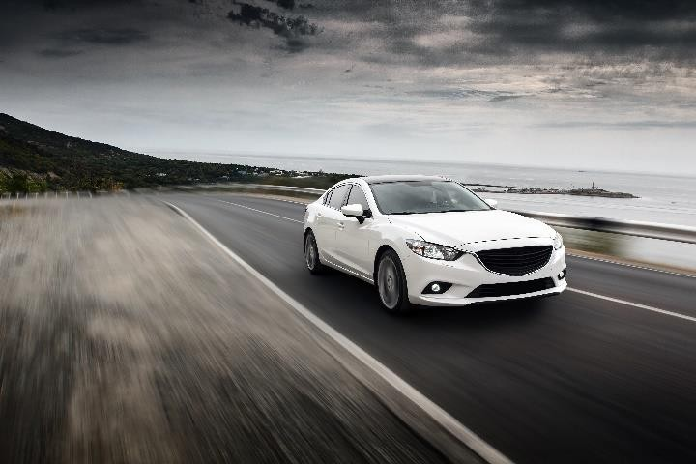
Let’s compare the cost of owing a car and using a rideshare /
taxi / cab service
Cost of buying a car
Insurance
Fuel
Cost of maintenance including repairs & parts
Time wasted on maintenance, parking etc.
Other i.e. parking tickets, traffic ticket etc.
Cost of rideshares

Slide 125
Rent or buy an apartment / flat – Introduction

Slide 126
Let’s imagine that Peter is considering 2 choice: buying an apartment or renting it. Let’s use the total cost of ownership to see what makes sense.
141

Slide 127
Let’s have a look at the information that Peter has
Buying the apartment would require EUR 150 K
Renting cost EUR 600 per month
Interest rate is 3%, inflation 2%, Wage increase is 5%
Peter currently earns EUR 30 per hour

